Slide 1
CYFS Architecture

Slide 2
CYFS架构支持的关键目标
任何人都有发布“有权数据”的权利： 任何数据经过数据确权后可以离线构成出如下链接：
该链接的可访问性只有其Owner有权控制
通过DSG机制
通过Cache机制
更多的有权数据通过真正的去中心互联网服务DEC Service构造并链接在一起（）

Slide 3


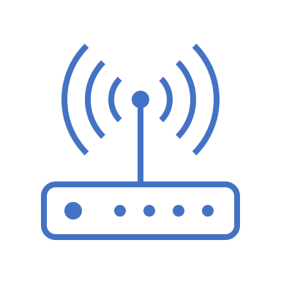


BTC,ETH…
Consensus-List Chain*
Bob’s Zone
Only OOD can receive requests from other Zones.(More safety)
Bob’s Device Read IM Message from OOD.
Bob SELL idle disk and earn token.
Meta-Chain is Non-Currency blockchain,
Users use other assets on the Meta-Chain
Bob Register Zone info on Meta-Chain
Meta-Chain
…
DEC Service IM
Query Bob’s Zone info from Meta-Chain
Photo
DSG Miner*
Alice’s Zone
Alice’s OOD*
IM Message(include a photo) direct send to Bob’s OOD
D3
@BDT protocol（P2P Tunnel）
All devices owned by Alice logically
belong to Alice’s Zone
There is at least 1 OOD in the Zone
Save all Alice's data on OOD
OOD is Zone’s center-server
DEC App Manager
Dave’s Zone
D
DSG Miner
DEC* Service IM
D
D1
gateway
Photo
Key1
Key3
Replica OOD
cyfs-stack
Owner can choose copies of data flexible, D had 5 Replicas.
Data store in other Zone MUST Encrypt.
Dave find DSG Provider by Consensus-List Chain.
Req Router
DSG* service
Routers can intercept or forward chunk req&resps to optimize network load
Key2
Alice’s IoT Device
Data Manage
Dave’s OOD
Alice’s PC
Automate CDN for popular content
Web3 DEC App
Web3 Native DEC App
Alice’s Phone
Web2
bridge
gateway
DSG Miner
IDC owners can build a cluster OOD (mining pool).
Cache Miner earns by selling idle bandwidth.
DSG Miner earns by selling idle space.
CYFS Browser
Web3 Mobile
DEC App
D2
WEB2 Browser
Cache Miner
cyfs-runtime
（user model cyfs-stack）
Embedded cyfs-runtime
Use Web2-bridge deployed in Miner-Pool to access cyfs://, CP or SP or User can pay for this.
Photo
BDT
Meta-Client

Slide 4
Part I : Ownership-Data Network
Store,Get,Transport,High Relaive,High

Slide 5
$cyfs get cyfs://eips/index.html
Owner
Public Key
3.calc owner-id
Hash & base58:
5r4M...V2md
cyfs://o/
Understand Object Link Design
Data is account
Get Owner’s Zone Info
Read OOD’s info from Zone Config
GET Named Object From OOD
GET ChunkData use BDT
MapObject
2.calc object-id
Hash & base58:
7jMme...UeV8Q
FileObject Map
index.html | 95Rva … pew
erc.html | 92Xab … x72
img/logo.png | 923B2 … va1
…
Owner
Public Key
FileObject
1.calc object-id
Hash & base58:
95Rva … pew
Signs
ChunkList
Chunk1 id
Chunk2 id
Chunk3 id
…
Chunk-id: Hash(ChunkData)
Chunk Data
Signs
* Any change will cause the ObjectId to change

Slide 6
cyfs-runtime(Protocl Stack)?
Web3 DEC App
CYFS Browser
Web3 Native DEC App
Hook cyfs:// => http://127.0.0.1/xxx
cyfs-sdk
cyfs-runtime
(user-model cyfs-stack)
BDT
RPC Service
Channel
Datagram
Stream
Router Client
BDT
Meta Client
P2P
Tunnel
P2P Crypto Tunnel
Crypted TCP
UDP
TCP or UDP

Slide 7
OOD System
DEC App Manage
Install upgrade
App image manage
App
Behavior logs
OOD-Daemon (Control basic service)
Start/Resume
Notify
ACL
Gateway
BDT=>HTTP
Data Firewall
App Manage
Create DEC Service sandbox
DEC App Sandbox
(docker)
http
DEC Service A
“Single Process HTTP Server”
Router
Service Handler
CYFS-Stack
Run/Verify
DEC*
DSG Backup
DEC Service B
RPC Service
file-manage
（default DEC Service)
Change APP’s Root State
Router Client
Primary- Replica Sync
BDT
Meta Client
Build App Cache
Storge Engine
App Root State Manager
chunk-manage
@Local FS
CYFS SDK
Object GC
SQLite or
MongoDB
ObjectFS
Object Cache
Chunk Cache

Slide 8
DEC App State Manage
Alice’s Replica OOD
Look & Review DSG Provider by DMC
Alice’s Primary OOD
包括OOD同步和数据备份，以及应用使用的服务
D
D
Key1
Key3
Key2
DSG Protocol:
Replica Check
Lightning Network Payments
D3
D1
Eva’s OOD
Bob’s OOD
D2
Dave’s OOD
Owner can choose copies of data flexible, D had 5 Replicas
Bob, Dave, Eva don't know the relationship of the D1,D2,D3

Slide 9
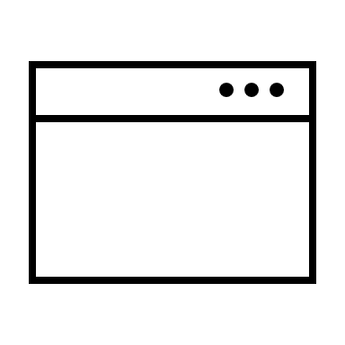
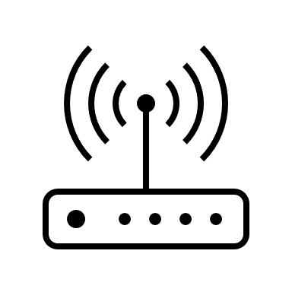
CacheNode Network
ZoneObject
Owner: 5r4M...V2md
OOD List: [5aSix…oenQzd]
CacheNodes:[
]
Owner’s Zone
Get from Owner’s Zone
5r4M...V2md‘ s Zone
OOD D
Browser
ZoneObject always on-chain
OOD D
OOD D
Block-Chain
V2md’s OOD
I know who has successfully
downloaded data!
GET Session
Chunk1
Resp ChunkData
Update NDN Context
NDN Context:
OOD A
OOD D
Source
OOD A
OOD B
OOD C
Chunk2
download data from end
OOD B
Chunk3
OOD C
BDT compliant Routers can recognize NDN requests,
intercept or forward them.(OOD D instant OOD C)

Slide 10
Proof of Service

Slide 11
Part II:用DEC Service生成NamedObject (writing)

Slide 12
DEC

Slide 13
App State

Slide 14
DEC App

Slide 15
介绍方式
整体设计
静态Web3
数据可靠性与可用性
================
动态Web3：RootState
动态Web3: 共识列表
动态Web3: DEC演算
动态得到的结果都是静态的

